Slide 1


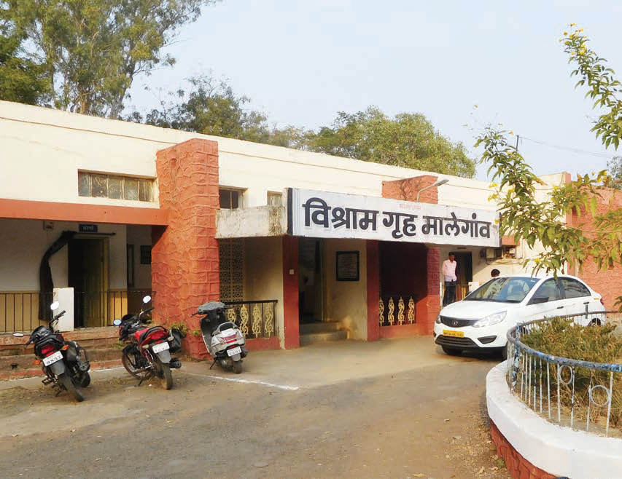
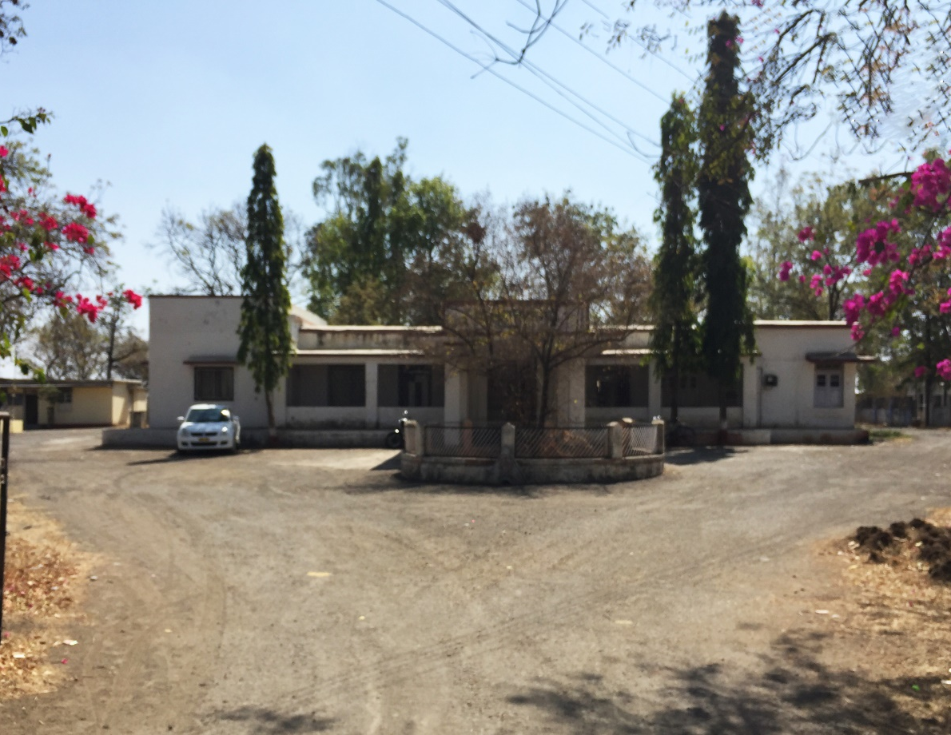
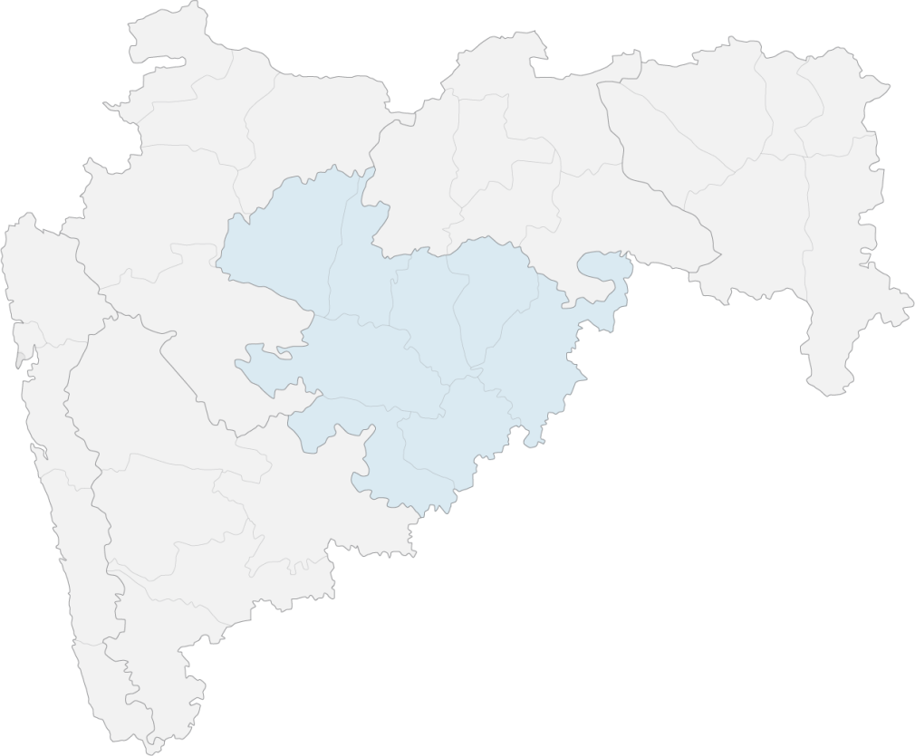

GRIHA EB
4 STAR
REST HOUSE, Bhokardan
Aurangabad division
The following strategies were adopted by the project teams to
reduce the impact of the existing building on the environment:
Site Parameters:
Trees preserved on site in the ratio of 1 tree per 80 sq.m.
Preferred parking provided for electric vehicles
Strategies implemented over 8,194 sq.m. of site are to reduce the Urban Heat Island Effect.
Energy:
Replacing old electrical equipment and appliances with BEE star rated ones has reduced the annual energy consumption from 3,492 kWh/year to 783 kWh/year
Solar photovoltaic system proposed of 2 kWp to generate 3120 kWh of renewable energy.
Water Efficiency:
Building water consumption reduced from 250.025 kiloliters/year to 234.257 kiloliters/year
The total sewage water generated on site is 0.57 kiloliters/day.
Human Health and Comfort:
Indoor comfort conditions measured in summer months; Dry bulb temperature= 27 - 29°C, Relative humidity= 26% – 28%, Daylight levels= 152 - 195 lux, Artificial lighting levels= 102 - 191 lux and Indoor noise levels: 43 - 48 dB; were compliant with benchmarks of the Indian Model for Adaptive comfort, SP41 and NBC 2005.
Location
Site Area
Built up Area
Typology
Rating Category
Version
Date of Award
Client
Integrated Design Team
Green Building Consultant
: Bhokardan, Jalna district, Maharashtra
: 10,180 sq.m.
: 244 sq.m.
: Hospitality
: GRIHA for Existing Buildings (EB)
: 1
: 31 May 2019
: Government of Maharashtra
: Public Works Department (PWD) Maharashtra
: Built Environment (India) Pvt. Ltd
Total energy offset
by renewables
= 558.6%
Total reduction in
building water demand
= 6.3%
TOTAL CARBON OFFSET BY THE PROJECT:
By planting native saplings & preserving existing trees: 4.11 ton/year
By conservation of conventional energy: 8.20 ton/year

